Slide 1
Greenhouse Gas Emission by Food System
Nirmala Devi Venkataraman
DDA6-Nashville Software School

Slide 2
Motivation
Hailing from family with agricultural background, its really important for me to analyze the environmental impact by our food system.
“We have to change how we produce and consume food, not just for environmental reasons, but because this is an existential issue for humans”- Janet Ranganathan, vice-president for science and research at the World Resources Institute (WRI).

Slide 3
Data Question
1)Which stage in food system emits high Carbidiooxide in regions of low food production?(i.e from food Production to Solid food waste disposal).
2) Which region emits high CO2 due to solid food waste? What is the major cause of Solid food waste.

Slide 4
Greenhouse Gas Emissions
Greenhouse gas emission can be broadly classified into
Food System Emissions
Non Food System emissions
Food System emissions contribute to nearly 20% of total green house emissions.
Food Systems Emission are categorized mainly as
(i) Land Use Change
(ii) Agriculture Production Activities
(iii) Food Transport
(iv) Food Waste Disposal

Slide 5
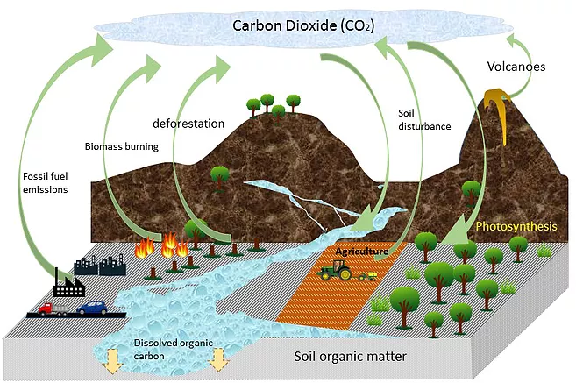
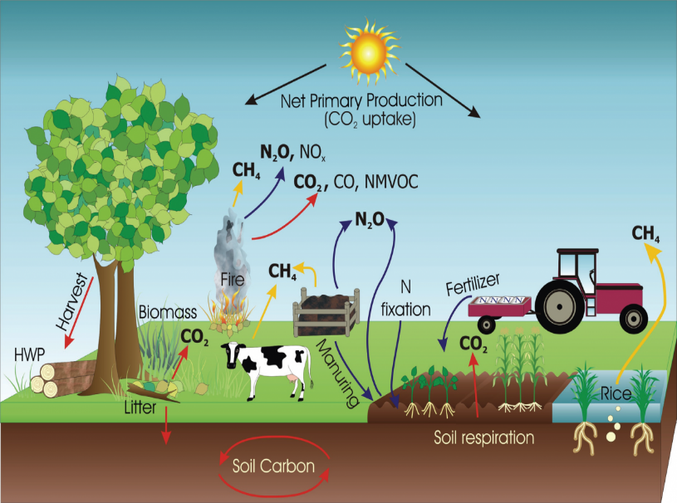

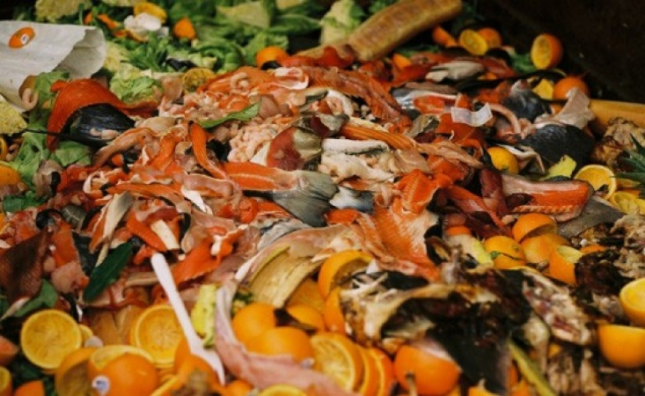
Emission- Food Stages
(i) Land Use Change (ii) Agriculture Production
(iii) Food Transport (iv) Food Waste

Slide 6
Agriculture Best Practices
Organic farming
Does not apply pesticides and artificial fertilizers but instead uses organic fertilizers and natural pesticide control.
No-till farming
Keep crop residues on the land and leave the earth largely undisturbed during planting
Manure
It consists of organic material. When manure is appropriately applied and incorporated, manure will increase the amount of carbon held in the soil. Integrated crop-livestock systems.
Integrated crop-livestock systems
Farms that include livestock on the landscape as well as crops are more beneficial in returning carbon to the soil and maintaining healthy soils.

Slide 7
Future Scope
To analyze the impact of Food production emissions on crop cultivation.
To analyze the factors contributing to solid food waste in regions of high under nourished population.
Data Source
https://www.fao.org/faostat/en/#data
https://www.unep.org/resources/report/unep-food-waste-index-report-2021

